Slide 1
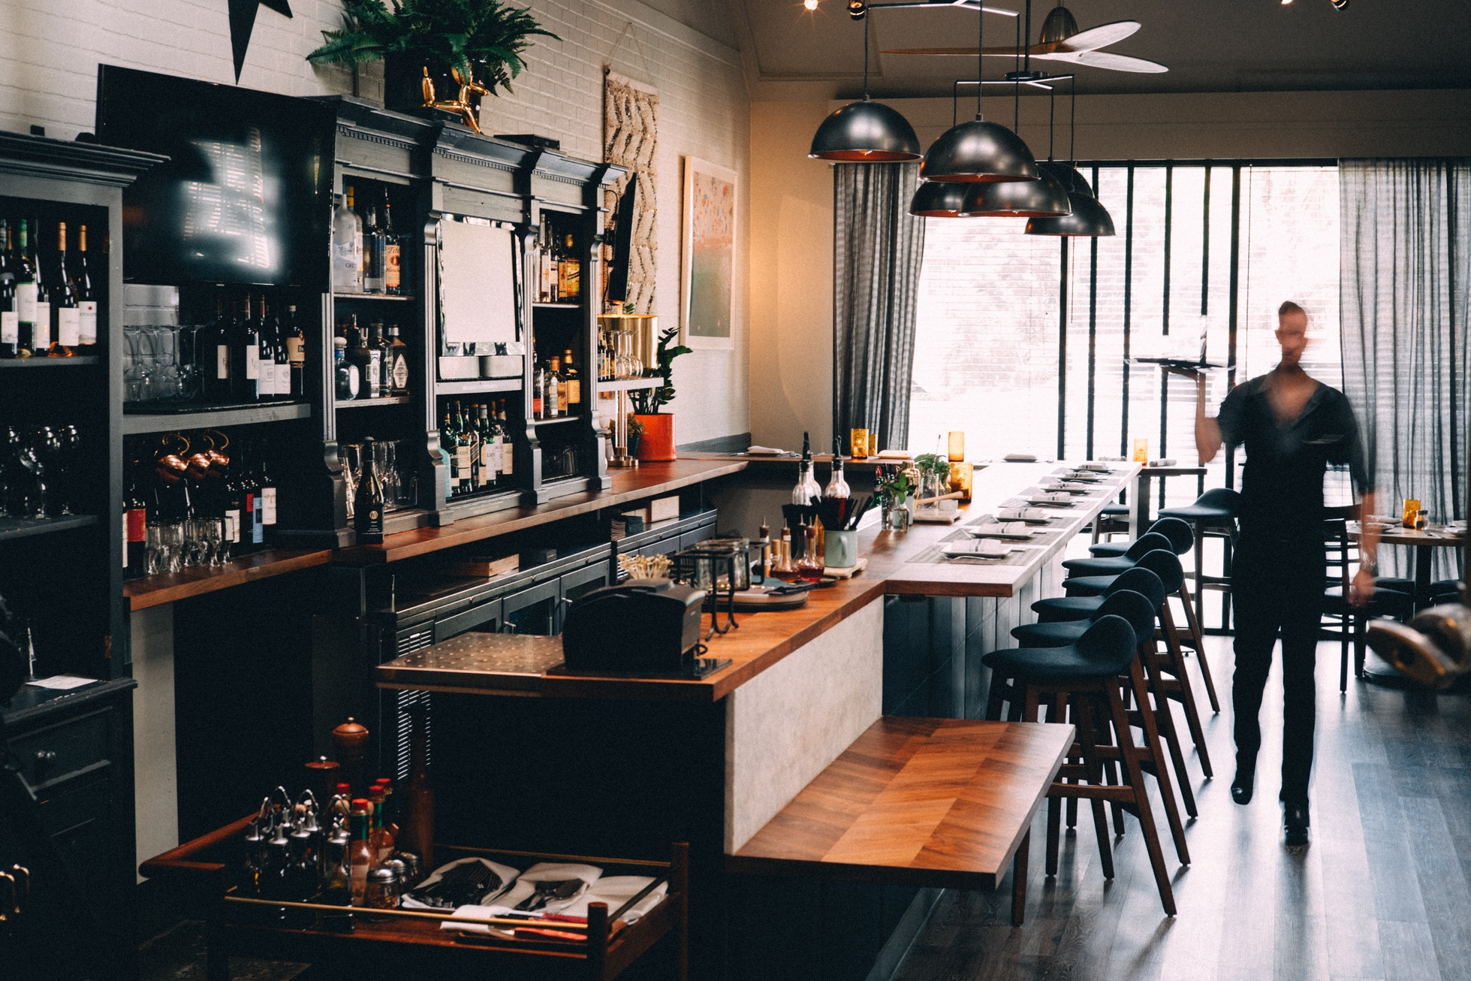
Booth Finder
A web application that helps users find nearby restaurants with real-time availability, customizable filters, and group coordination features.

Slide 2




Project Overview
TACKLE THE CHALLENGE OF SECURING LAST-MINUTE RESTAURANT RESERVATIONS
OFFER REAL-TIME UPDATES ON RESTAURANT AVAILABILITY
INTEGRATE VARIOUS TRAVEL MODES
ENABLE GROUP COORDINATION
Including walking, driving, public transit, and rideshare, displaying restaurants within a convenient travel radius.
Users can share restaurant options through a link and allow friends to vote on their preferred choice.
Users can filter results by cuisine, price, ratings, and specific preferences like dietary requirements or outdoor seating.
The app caters to spontaneous diners seeking quick access to nearby dining options.
THE APP BENEFITS BOTH DINERS AND RESTAURANTS BY FACILITATING LAST-MINUTE RESERVATIONS, ENHANCING CUSTOMER CONVENIENCE, AND OPTIMIZING RESTAURANT PROFITABILITY.

Slide 3
Problem Statement
LACK OF REAL-TIME AVAILABILITY
Existing solutions often fail to provide up-to-date information on restaurant availability, leaving diners unsure about securing last-minute reservations.
INADEQUATE FILTERING OPTIONS
Current platforms offer limited filters, making it difficult for diners to find restaurants that match their specific preferences such as cuisine, price range, ratings, and dietary requirements.
LIMITED GROUP COORDINATION FEATURES
Existing solutions lack features that enable groups of diners to collaborate and collectively decide on a restaurant, hindering spontaneous plans and last-minute group outings.

Slide 4
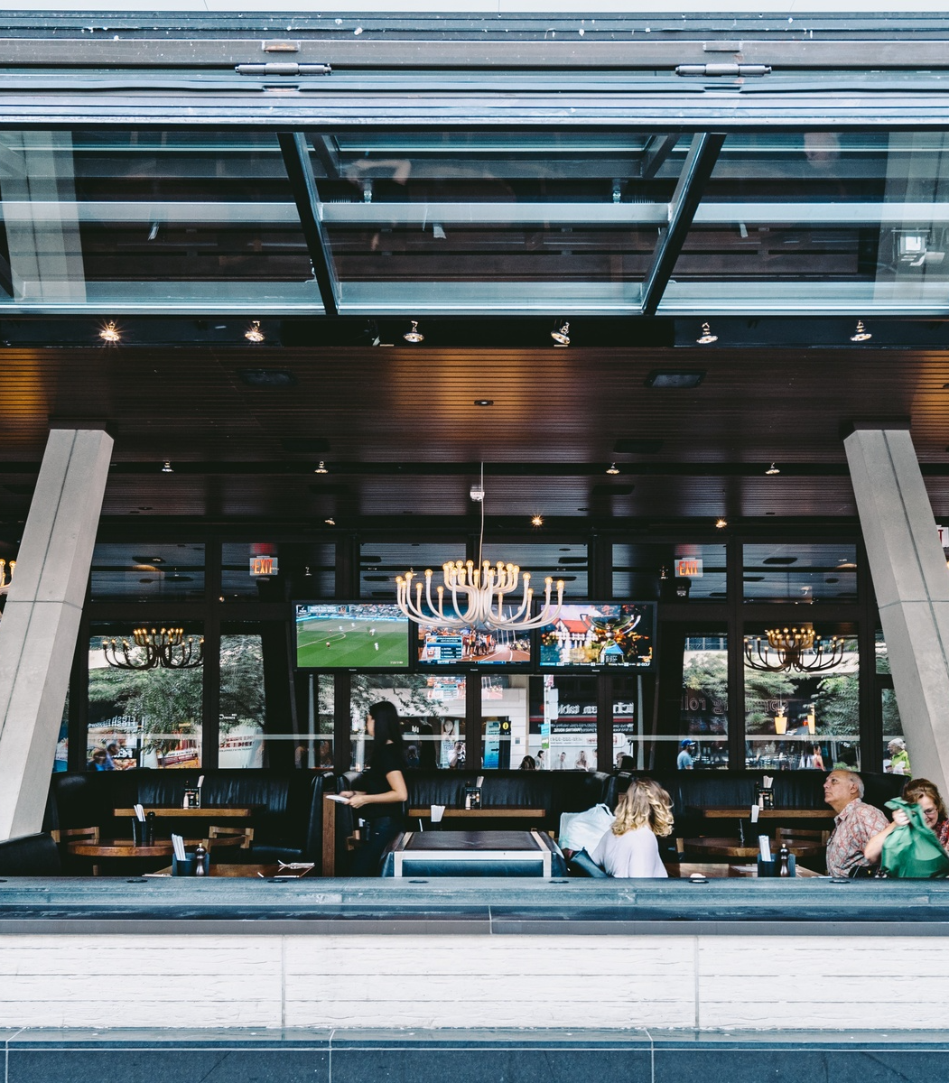
Proposed Solution
The proposed solution is an app that offers real-time updates on restaurant availability and allows users to filter results by various criteria, including cuisine, price, ratings, dietary requirements, and outdoor seating preferences. It integrates multiple travel modes, such as walking, driving, public transit, and rideshare, to display restaurants within a convenient travel radius. The app also features a standout group coordination function, enabling users to share restaurant options with friends and allow them to vote on their preferred choice.

Slide 5
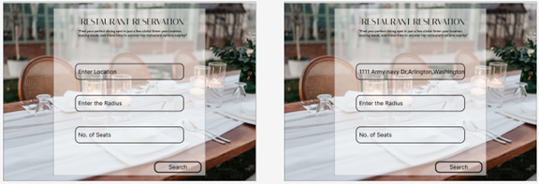
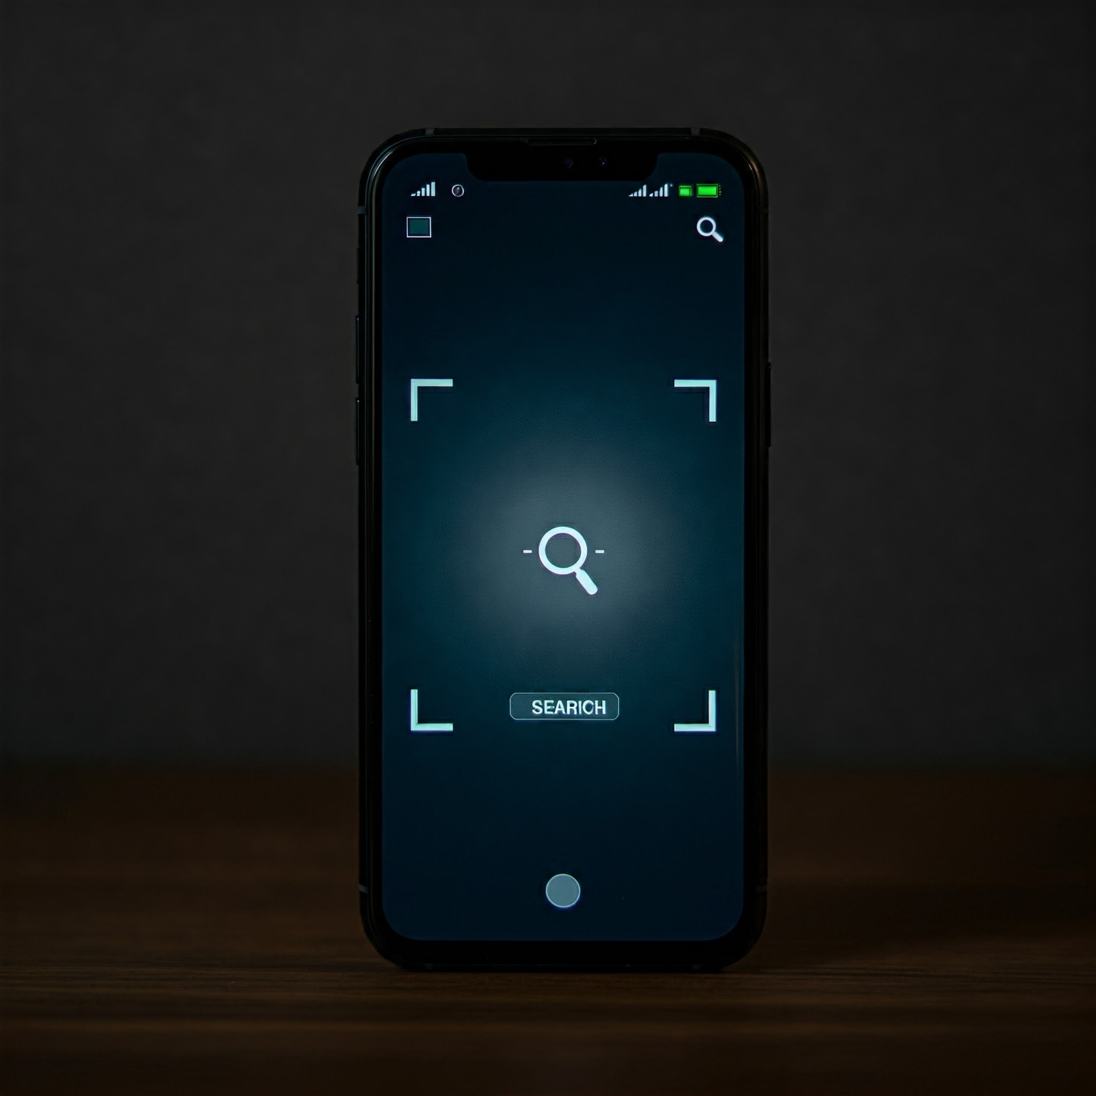
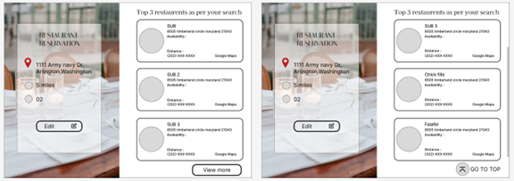
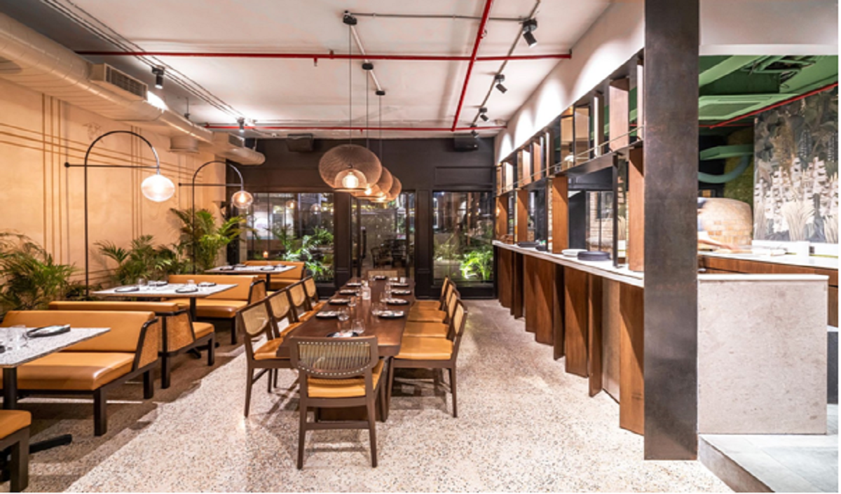
Web Prototype Design
LANDING PAGE
SELECTING RADIUS
TOP 3 RESULTS
RESTAURANT DETAILS
This is the initial landing page of the reverse restaurant search app, where users can start their search for nearby dining options.
Users can specify a desired travel radius to filter restaurants within a convenient distance.
The app displays the top 3 recommended restaurants based on the user's search criteria.
Clicking on a restaurant result shows detailed information about the establishment, including availability, travel time, and a link to make a reservation.

Slide 6
Frontend Development
REACT.JS
JAVA
RESPONSIVE DESIGN
Utilized React.js framework to build the responsive web application.
Leveraged Java programming language for certain frontend components.
Developed a responsive UI that adapts to various screen sizes and devices.
SEARCH FUNCTIONALITY
RESTAURANT DISPLAY
Implemented a comprehensive search feature allowing users to filter restaurants by location, seating preferences, and walking time range.
Displayed restaurant details, including phone number, address, availability, and travel time.

Slide 7



Backend Development
REAL-TIME RESTAURANT AVAILABILITY
DYNAMIC FILTERING
EXTERNAL PLATFORM INTEGRATION
DATA ACCURACY

Slide 8
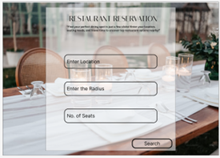
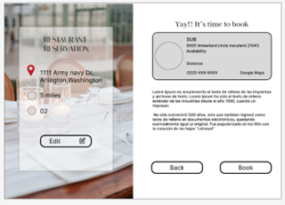
Sample Work
LANDING PAGE
SEARCH RESULTS
RESTAURANT DETAILS
The app's landing page showcases the search functionality, allowing users to input their location, seating preferences, and walking time range.
The app displays the top three recommended restaurants based on the user's preferences, along with the option to view more alternatives.
Detailed information about each restaurant, including phone number, address, availability, and travel time, is presented to help users make informed decisions.

